Slide 1
The journey at greenfox /WEEK04/
“Far from what I once was but not yet what I’m going to be”

Slide 2
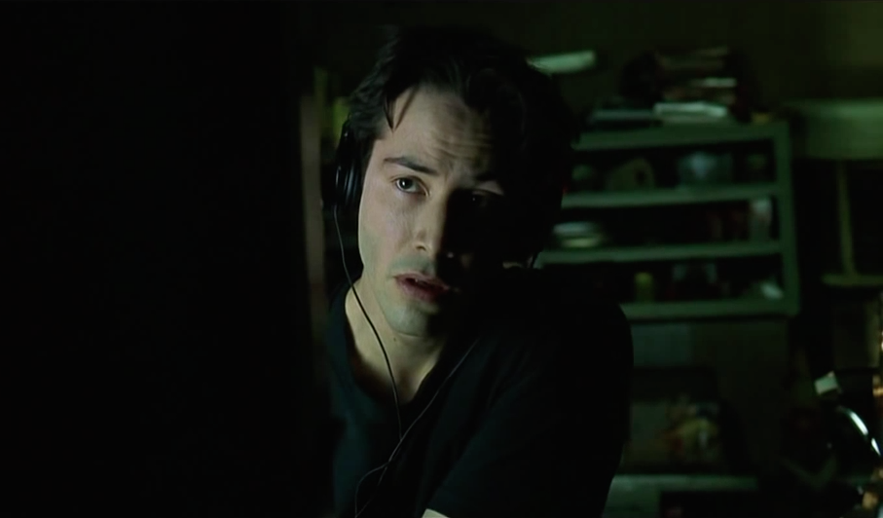

THE weekend
GET READY FOR THE EXAM
Lack of time = stress

Slide 3

First Day
Managing time
Precision
Need more practice

Slide 4
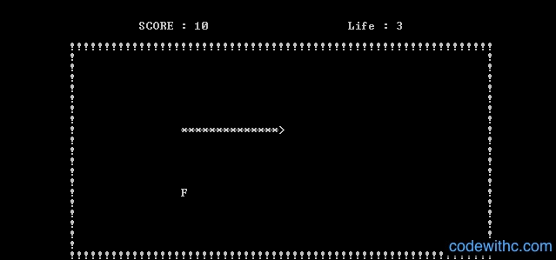
First Day
Practice in the classrom
Odd even
Userinput
Loops
Fibonacchi
Switch-case
Party
snake

Slide 5
sECOND day
Practice in the classroom
Styleguide
Arrays
Pointers
Dynamically allocated memory
Data structures
Unfinished circular buffer
Feeling of success

Slide 6
Third day
Whole day circular buffer
End of the day ToDoList
Feeling of Success

Slide 7
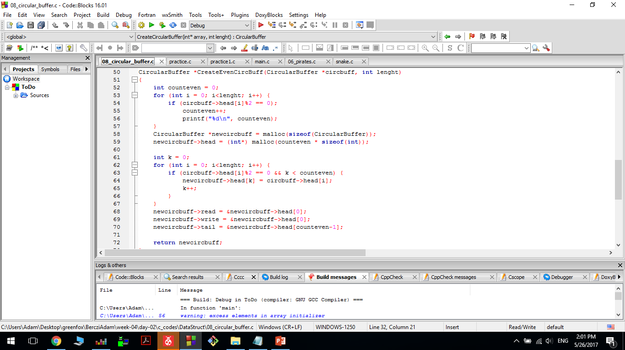

Slide 8
fourth day
ToDoLIST
STRTOK
STRCPY
No sleep

Slide 9
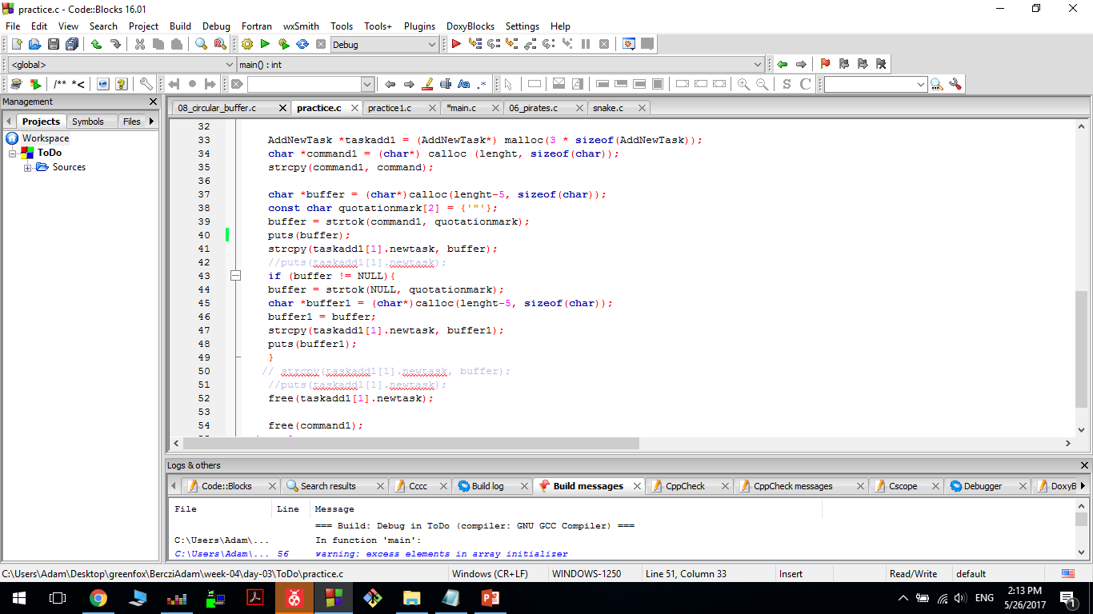

Slide 10
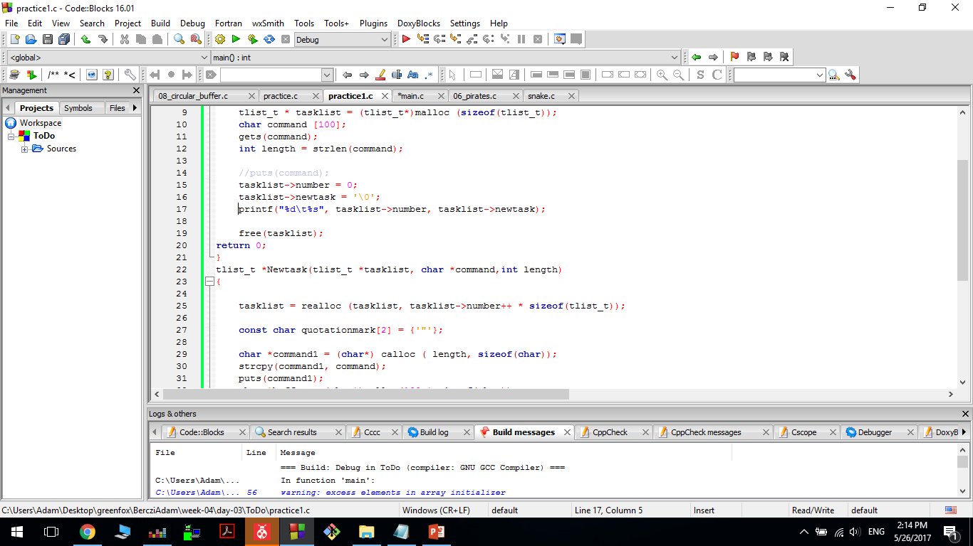

Slide 11
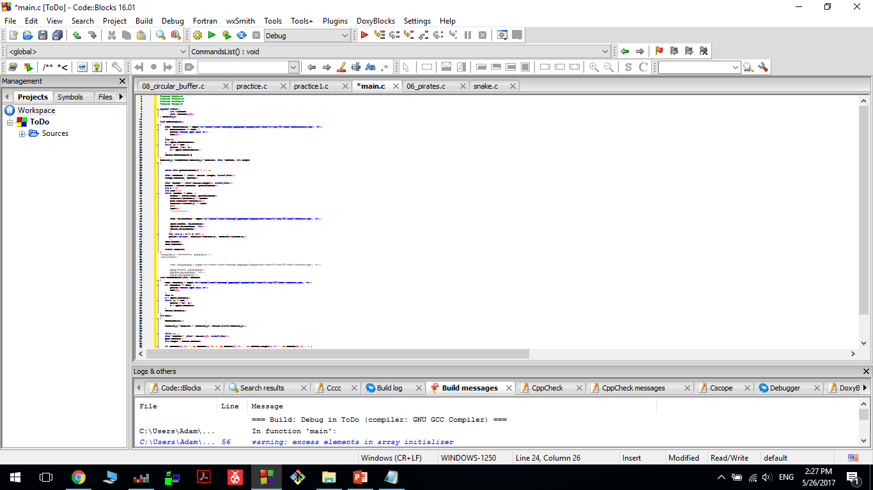

Slide 12

FIFTH day
TODOLIST CONTINUE…
I will become a Robot

Slide 13
THANK YOU for your attention

